Slide 1
Lending Case Study
By Shubham Mittra
ML-41

Slide 2
Introduction
As per given Dataset analysis has been done for risk analytics in banking and financial services sector.
How data is being used to minimise the risk of losing money while lending to customers.
EDA has been done to understand how consumer attributes and loan attributes influence the tendency of default.
The EDA has been done to understand the driving factors (or driver variables) behind loan default, i.e. the variables which are strong indicators of default.

Slide 3
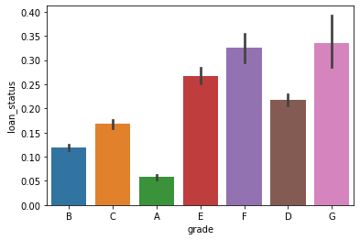
Grade vs Loan Status
The graph shows the grading system as per the loan status of the clients,
We can understand how grading is important in allotting loans to the customers

Slide 4
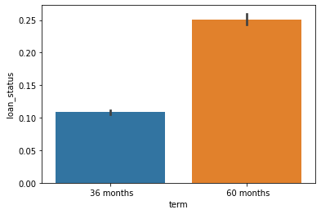
Term vs Loan status
The graph explains the different term policies clients opt for, which itself shows an underlying trend that most clients opt for longer duration loans.

Slide 5
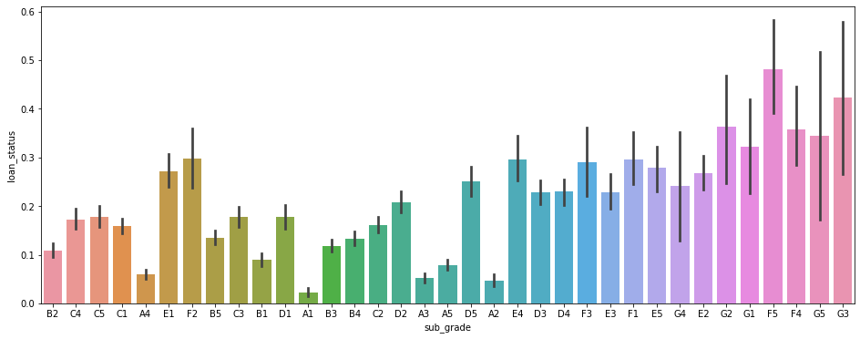
Sub Grade vs Loan Status
The graph shows different grades or sub grades given to the clients as per their Loan status

Slide 6
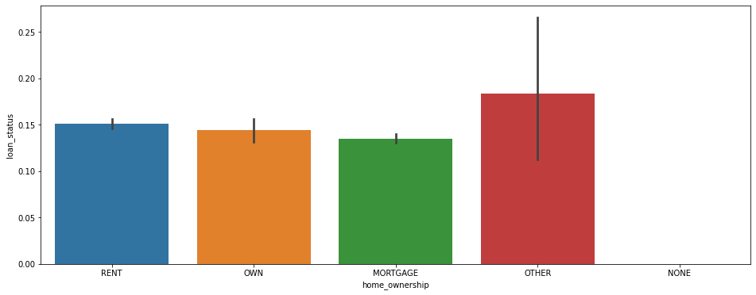
Home Ownership vs Loan Status
The graph shows different kinds of home ownership patterns given by the clients as per their Loan status

Slide 7
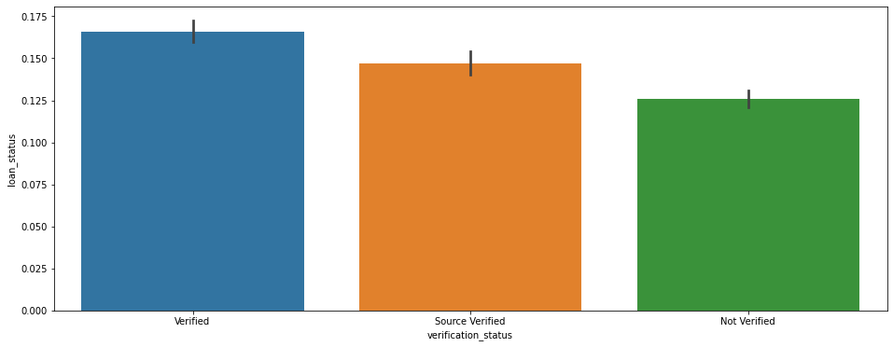
Verification vs Loan status
The graph shows different kinds of verification status given by the clients as per their Loan status.

Slide 8
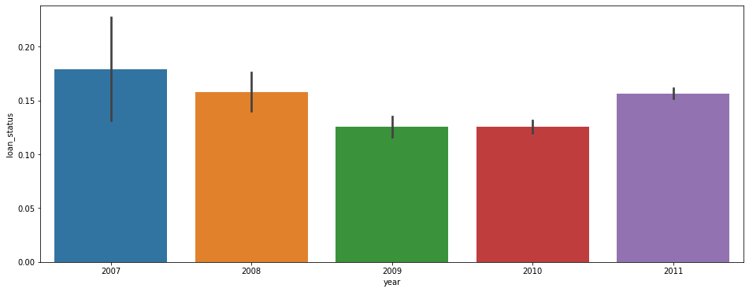
Year vs Loan status
The graph shows different years of loan patterns given by the clients as per their Loan status.

Slide 9
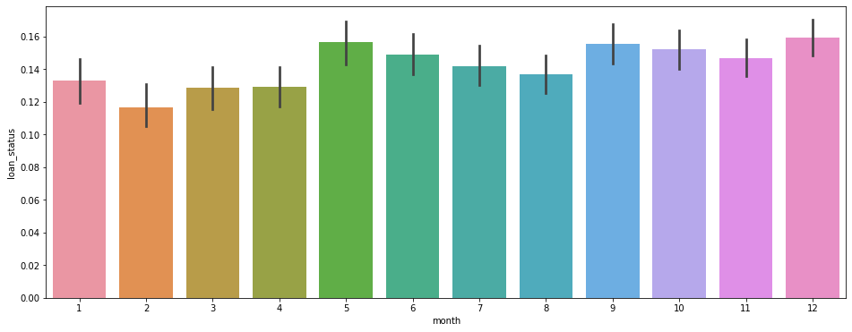
Month vs Loan status
The graph shows different kinds of months loan pattern given by the clients as per their Loan status.

Slide 10
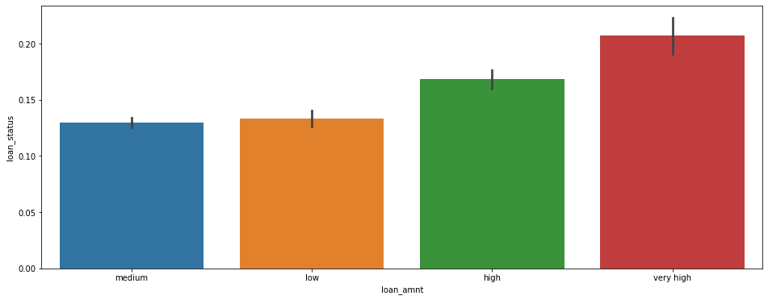
Loan amount vs Loan status
The graph shows different loan amount asked or given to the clients as per their Loan status.

Slide 11
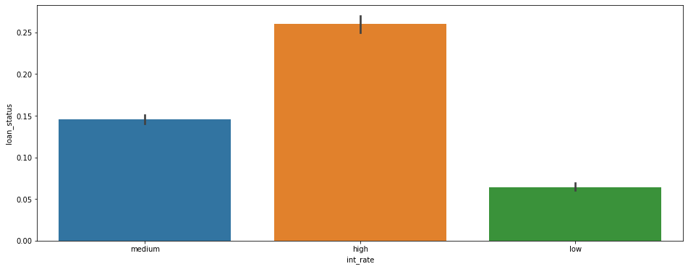
Interest rate vs Loan status
The graph shows different kinds of interest rates allotted or given to the clients as per their Loan status.

Slide 12
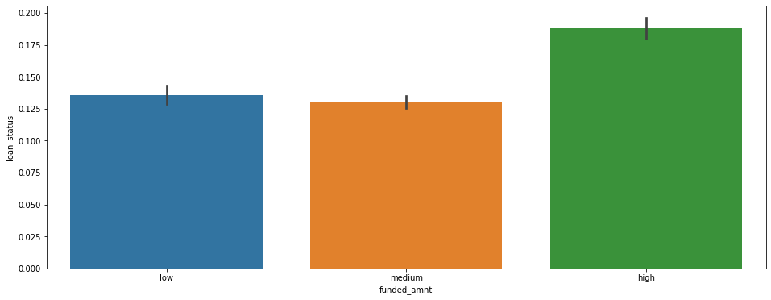
Funded amount vs Loan status
The graph shows agency approved amount patterns given for the clients as per their Loan status.

Slide 13
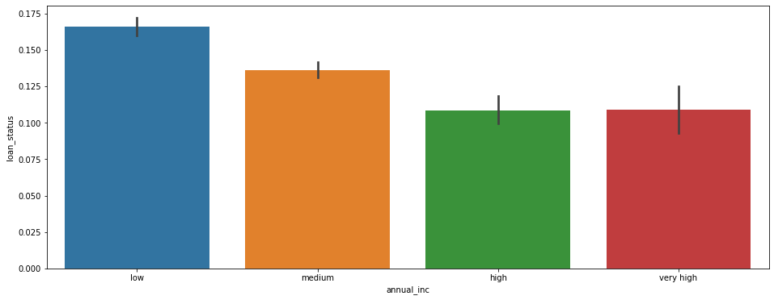
Annual Income vs Loan status
The graph shows different annual income patterns of the clients as per their Loan status.

Slide 14
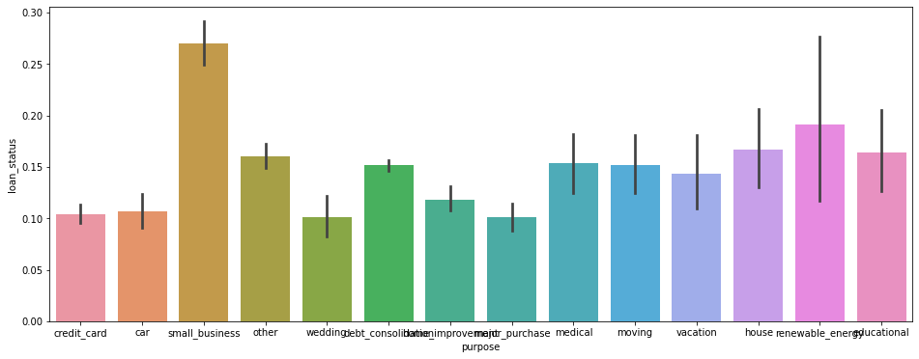
Purpose vs Loan Status
The graph shows different of purposes given by the clients as per their Loan status.

Slide 15
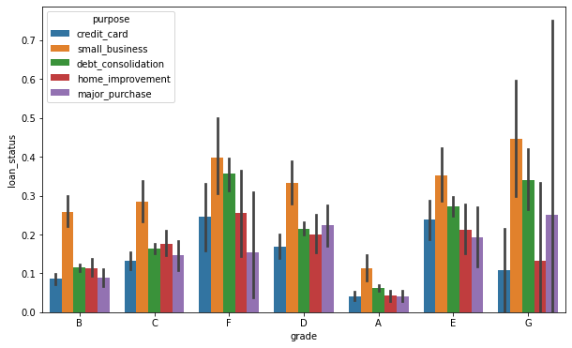
Grade vs Loan Status vs Purpose
The graph shows different kinds of grading system according to their purpose patterns given by the clients as per their Loan status.

Slide 16
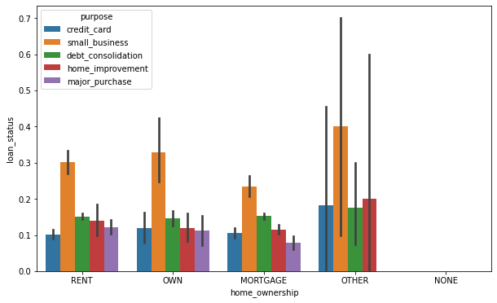
Home Ownership vs Loan status vs Purpose
The graph shows different kinds of home ownerships according to their purpose patterns given by the clients as per their Loan status.

Slide 17
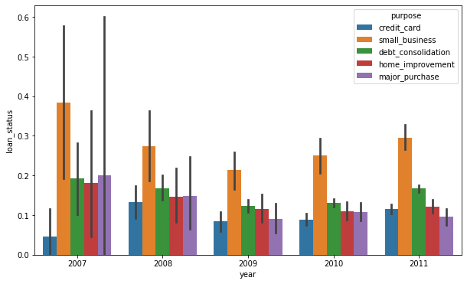
Year vs Loan status vs Purpose
The graph shows different kinds of loan years according to their purpose patterns given by the clients as per their Loan status.

Slide 18
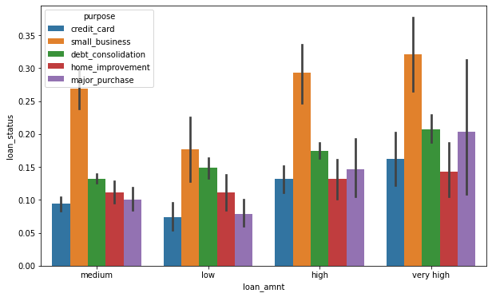
Loan amount vs Loan status vs Purpose
The graph shows different kinds of approved agency amount according to their purpose patterns given by the clients as per their Loan status.

Slide 19
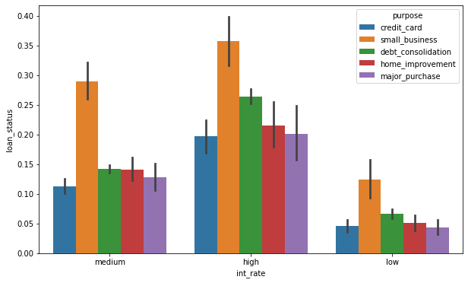
Interest Rate vs Loan status vs Purpose
The graph shows different kinds of interest rates allotted to clients according to their purpose patterns given by the clients as per their Loan status.

Slide 20
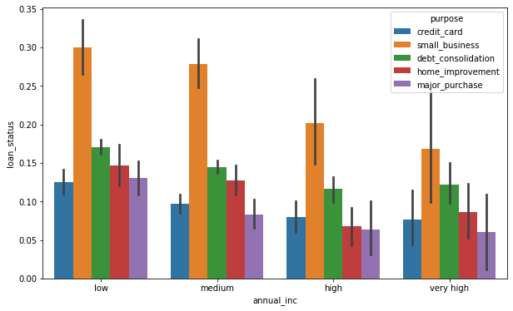
Annual Income vs Loan status vs Purpose
The graph shows different kinds of incomes statements as per their purpose(business) given by the clients Loan status.

Slide 21
Thank You
Shubham Mittra
ML-41

